Slide 1

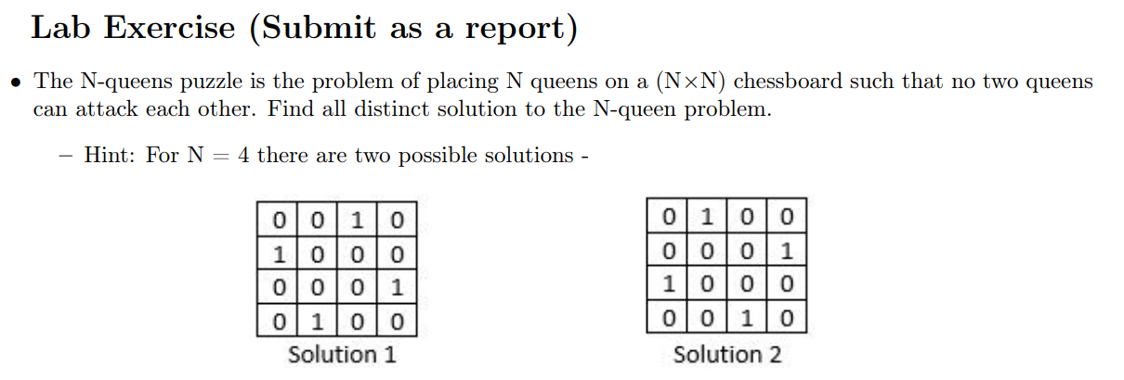
Green University of Bangladesh
Department of Computer Science and Engineering (CSE)
Faculty of Sciences and Engineering
Spring 2024, B.Sc. in CSE (DAY)
Lab Report NO # 06
Course Title: Artificial Intelligence Lab
Course Code: CSE 316 Section: CSE 213 – D1
Problems / Tasks / Domains:
Student Details
Name | ID
Md. Shahidul Islam Prodhan | 213902017
Lab Assigned Date: 7th May 2024
Submission Date: 7th May 2024
Course Teacher’s Name: Fairuz Shaiara, Lecturer
[For Teacher’s use only: Don’t write anything inside this box]
Lab Report Status
Marks: | Signature:
Comments: | Date:

Slide 2
1. TITLE OF THE LAB REPORT EXPERIMENT
Solve N-Queen Problem Using Backtracking Algorithm.
2. OBJECTIVES/AIM
To understand how backtrack algorithm performs to solve constraint satisfaction problem
To understand how N-queen problem is solvable by using backtrack method.
3. PROCEDURE / ANALYSIS / DESIGN
Procedure:
The N-Queens problem-solving approach implemented in this report follows a backtracking algorithm. The procedure involves recursively exploring all possible placements of queens on the chessboard, ensuring that no two queens attack each other.
Analysis:
Initialization:
The program starts by taking user input for the number of queens to be placed on the chessboard.
An instance of the NQueen class is created with the input value.
Backtracking Algorithm:
The program utilizes a backtracking algorithm to explore all possible configurations of queen placements.
The solve_nq_util method recursively tries to place queens on the board, column by column, while ensuring that no two queens attack each other.
If a solution is found, it is appended to the list of solutions.
Printing Solutions:
Once all solutions are found, the program prints the total number of distinct solutions and then prints each solution's configuration.
Design:
Class Structure:
The program is structured around the NQueen class, which encapsulates the methods and attributes necessary for solving the N-Queens problem.
Methods such as print_solution, is_safe, solve_nq_util, and solve_nq are defined within the class to facilitate the solution process.
Data Storage:
Solutions are stored in a list within the NQueen class, allowing for easy retrieval and printing.
User Interaction:
The program interacts with the user through the console, prompting for the number of queens to be placed on the chessboard.

Slide 3
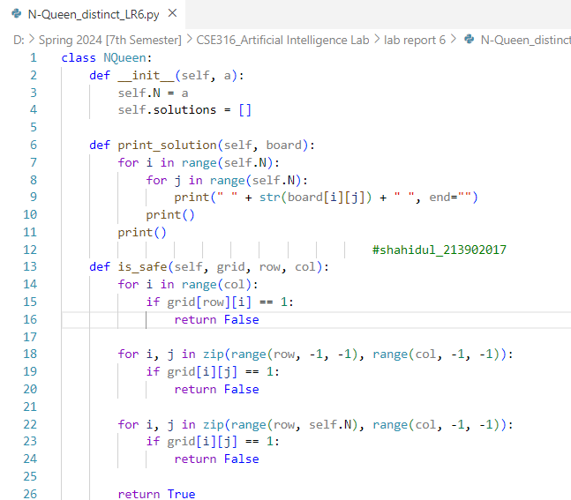
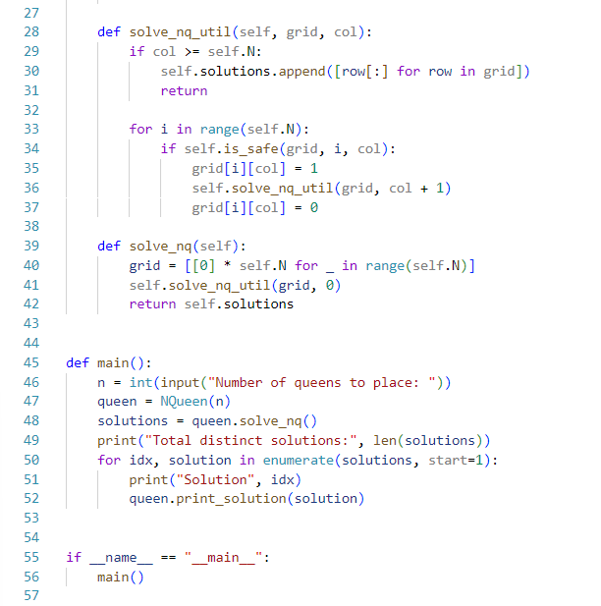
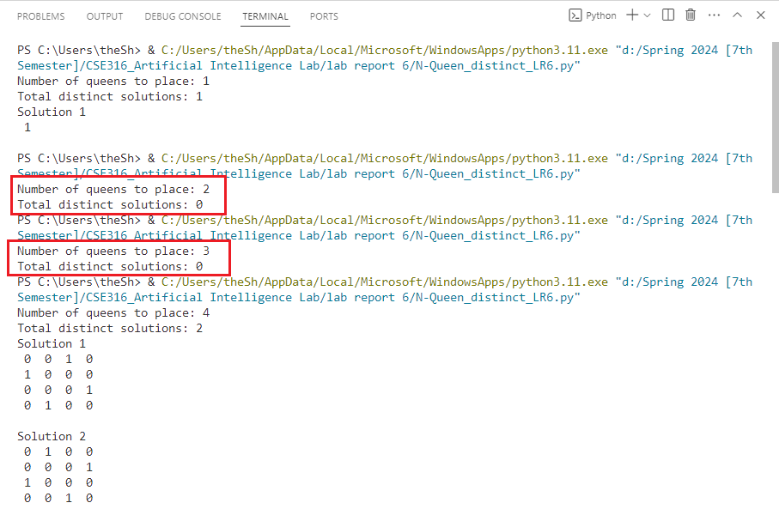
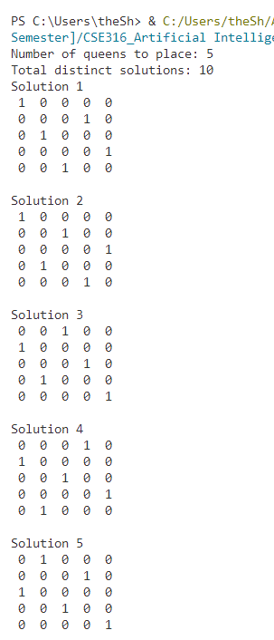
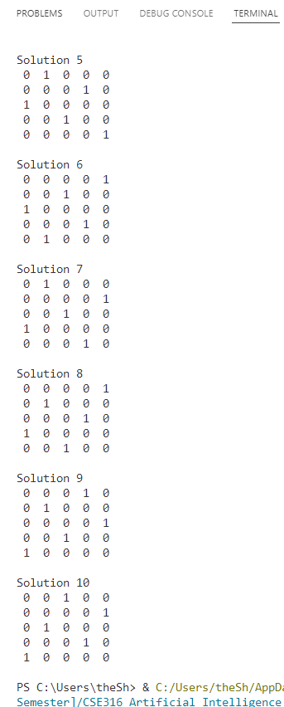
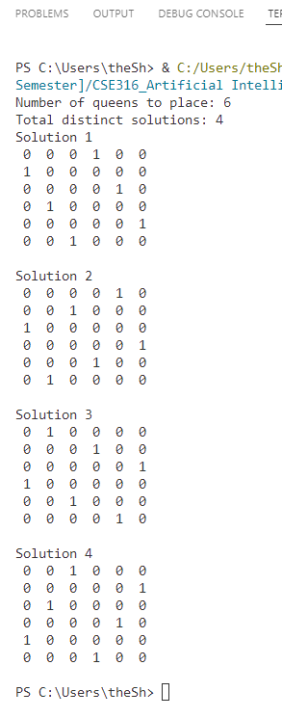
4. IMPLEMENTATION
5. TEST RESULT / OUTPUT
Test Cases:
Num of n (queen) | Num of Total Distinct Solution
1 | 1
2 | 0
3 | 0
4 | 2
5 | 10
6 | 4

Slide 4
6. ANALYSIS AND DISCUSSION
The implemented N-Queens solver exhibits robustness in finding valid configurations while adhering to the problem's constraints. It effectively utilizes a backtracking algorithm to explore all possible placements, ensuring correctness in the solutions. However, its efficiency is contingent on the board size, with larger sizes leading to exponential growth in computation time. Memory usage could also become a concern, especially for larger boards with numerous solutions. The program's user interface is intuitive, simplifying user interaction and solution presentation. Nonetheless, addressing symmetries to eliminate duplicate solutions remains a key area for improvement, enhancing solution accuracy. Overall, while the solver effectively tackles the N-Queens problem, enhancements in efficiency, memory management, and symmetry handling could further optimize its performance.
7. SUMMARY
In summary, the implemented solution effectively solves the N-Queens problem using a backtracking algorithm. It provides a robust framework for finding and printing all distinct solutions for a given board size. While the solution correctly identifies solutions and interacts with the user, further enhancements could be made to improve efficiency and handle symmetries to ensure that only unique solutions are counted.

